Slide 1

MALtepe university
TURKISH JOKE GENERATOR LLM
SE 403
Software Project Management

Slide 2



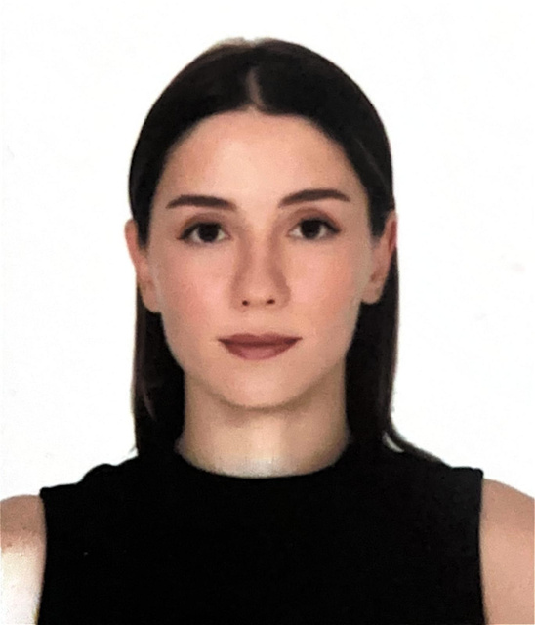


MEET WITH GROUP 7
Ömer Faruk Özer
Furkan Aksoy
Emre Sarı
Scrum Master/Model Developer
Lead Developer
Front-End Developer
Yaren Yıldız
Mehmet Güzel
Tamay Yazgan
Data Scientist
Back-End Developer
QA Tester

Slide 3
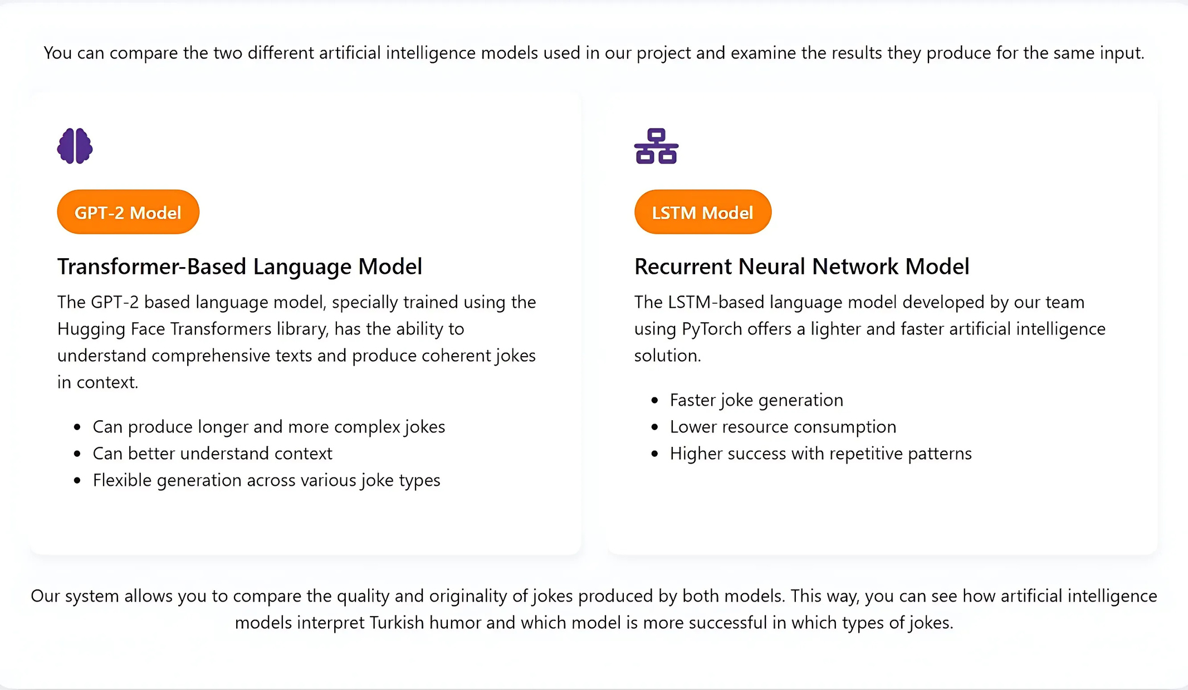
PROJECT INTRODUCTION

Slide 4

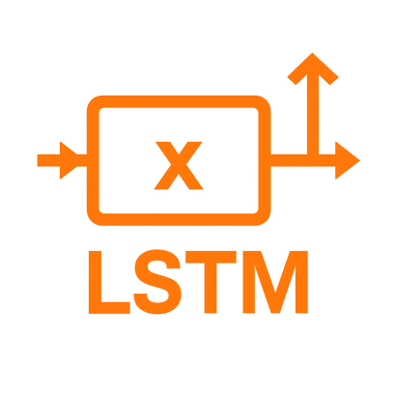




TECHNOLOGIES
The GPT-2 model was
fine-tuned with our dataset.
Back-end was developed using Flask and model training with Python.
An LSTM model was
developed from scratch.
A website skeleton
was created using HTML.
Bootstrap was used for
effects and enhancements.
Website designs
were created using CSS.

Slide 5

CHALLENGES
The technical challenges we faced were significant:
Building a comprehensive dataset of Turkish jokes
Fine-tuning language models for Turkish content
Developing evaluation metrics for humor quality
Creating a responsive web interface for interacting with our models

Slide 6
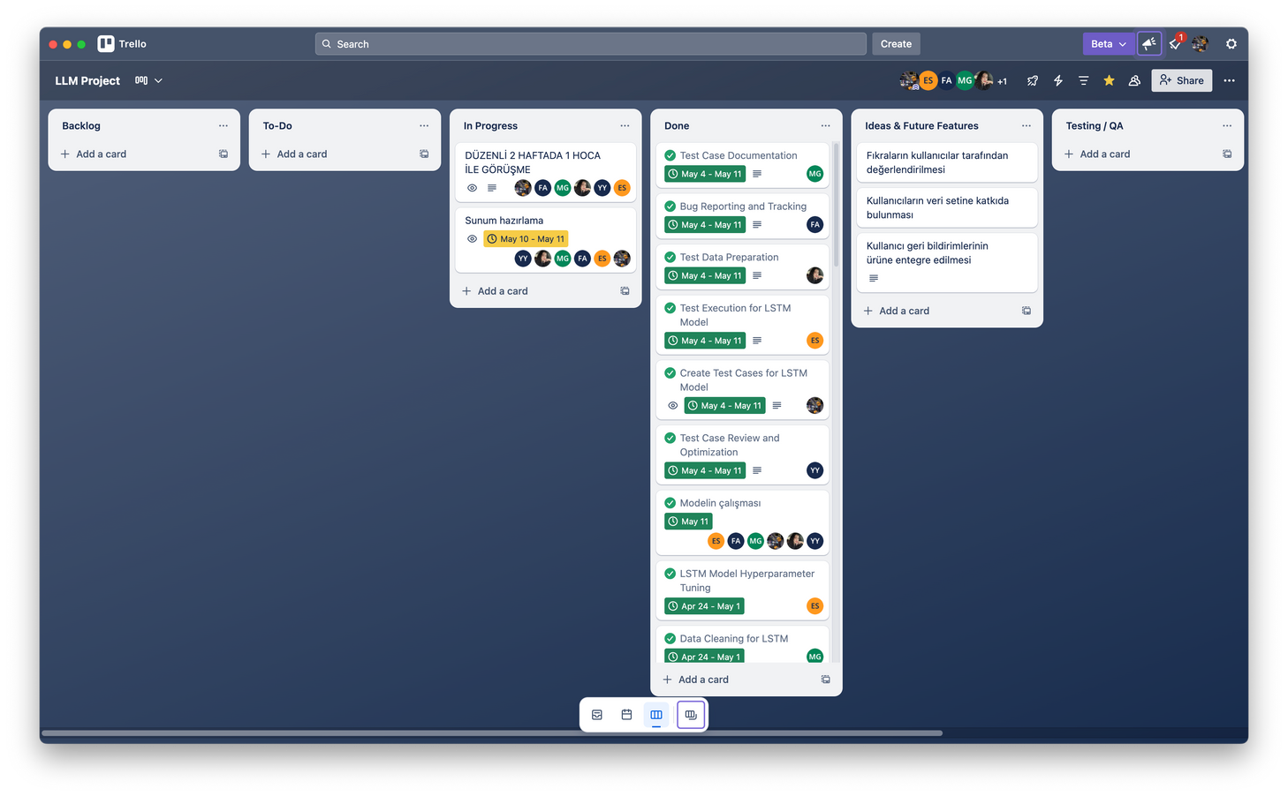
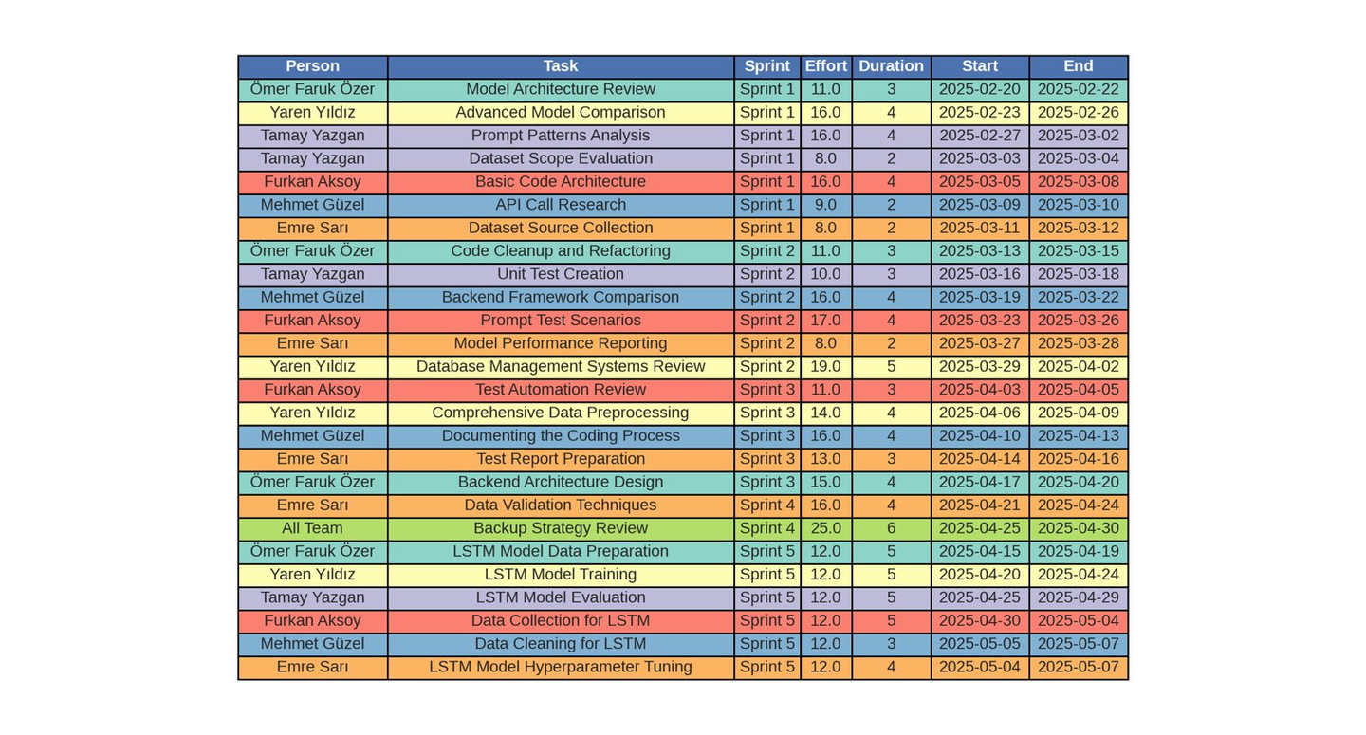
PROCESS
Trello
Effort And Duration Table
Throughout our development cycle, we implemented Scrum methodologies with two-week sprints, daily stand-ups, and regular retrospectives to continuously improve our approach. This enabled us to iterate quickly and address challenges as they arose.

Slide 7

DATASET PREPARATION AND SIMILARITY ANALYSIS
I led the data collection and preprocessing efforts for this project.
To train effective joke generation models, we needed a substantial and diverse dataset. We compiled a corpus of 7,500 traditional Turkish jokes across three categories: Nasreddin Hoca, Temel, and general jokes.

Slide 8
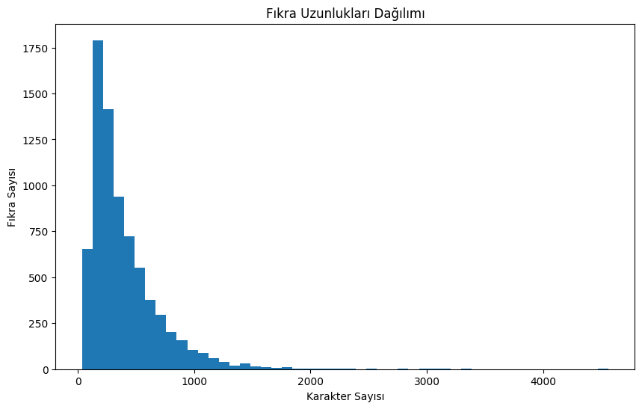
JOKES LENGTH DISTRIBUTION

Slide 9

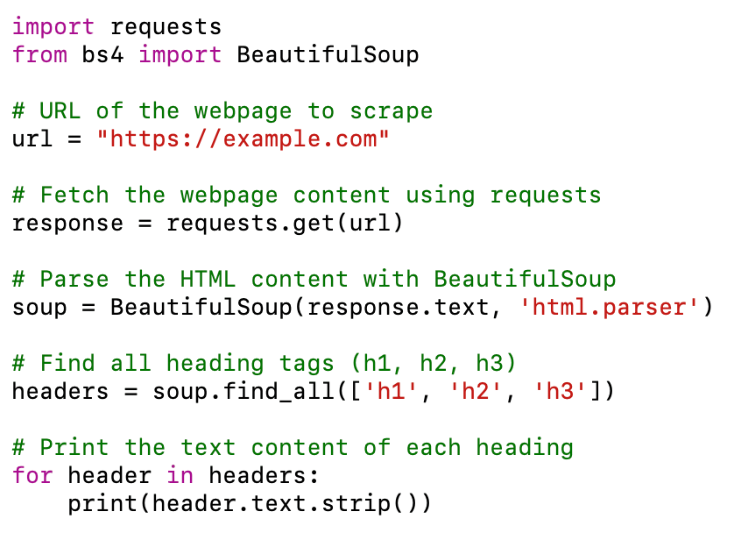
WEB SCRAPING
Jokes were automatically collected from
the internet as data using web scraping.

Slide 10

DATA COLLECTION
Our data collection methodology combined multiple approaches:
Web scraping from cultural websites and joke archives
Optical Character Recognition (OCR) on digitized joke books
Manual transcription from printed joke collections
Data augmentation techniques for underrepresented categories
The dataset was structured in JSON format with three key fields:

Slide 11
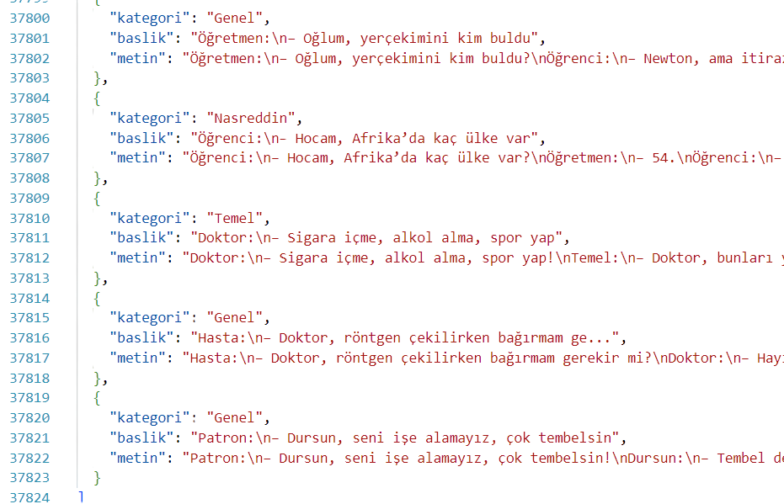
DATASET JSON FORMAT
We determined three headings for the dataset format: Kategori, Baslik and Metin.

Slide 12

JOKE SIMILARITY CHECK & OVERFITTING PREVENTION
First, we load all jokes from our JSON files and clean them—removing punctuation, extra spaces, and converting to lowercase. For each newly generated joke, we compute a similarity ratio against every stored joke using Python’s SequenceMatcher and record the highest score.
If the score exceeds 0.8, we flag it as a duplicate and discard it. Scores between 0.5 and 0.8 trigger a manual review. Anything below 0.5 we accept as novel. This check prevents the model from simply repeating training data, curbs overfitting, and ensures every joke our system produces is genuinely fresh.

Slide 13
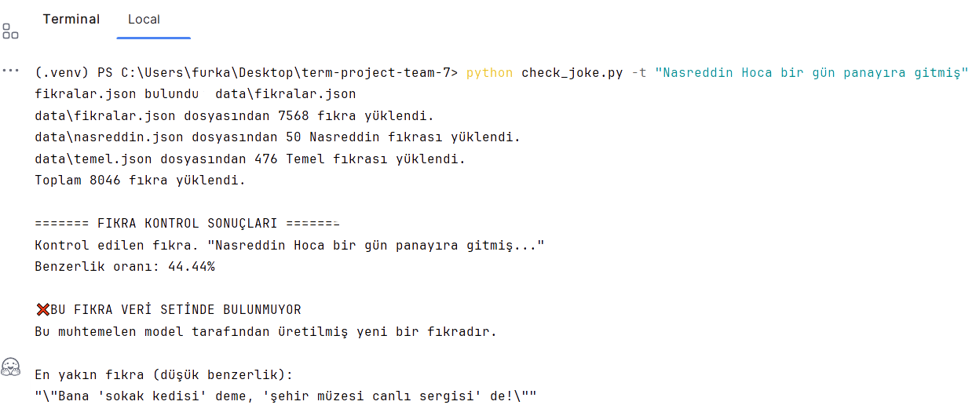

CHECK DATASET
The script loads a total of 7,500 jokes from three JSON files and then computes a 44.44% similarity score for the input “Nasreddin Hoca bir gün panayıra gitmiş.” Since this is below the 50% threshold, it flags the joke as not found in the dataset and likely newly generated by the model.

Slide 14

GPT-2 MODEL TRAINING AND IMPLEMENTATION
For this project, we specifically selected and fine-tuned a GPT-2 architecture to work exclusively with Turkish joke generation. Unlike approaches that begin with English-pretrained models, we focused on optimizing our model entirely for Turkish language patterns and humor structures from the outset.

Slide 15

GPT-2 FOR TURKISH JOKE GENERATION
Our training was conducted exclusively on our specialized corpus of 7,500 Turkish jokes across three distinct categories. This approach ensured that the model developed a deep understanding of Turkish linguistic patterns, cultural references, and the unique structural elements of different joke types within Turkish humor tradition.

Slide 16
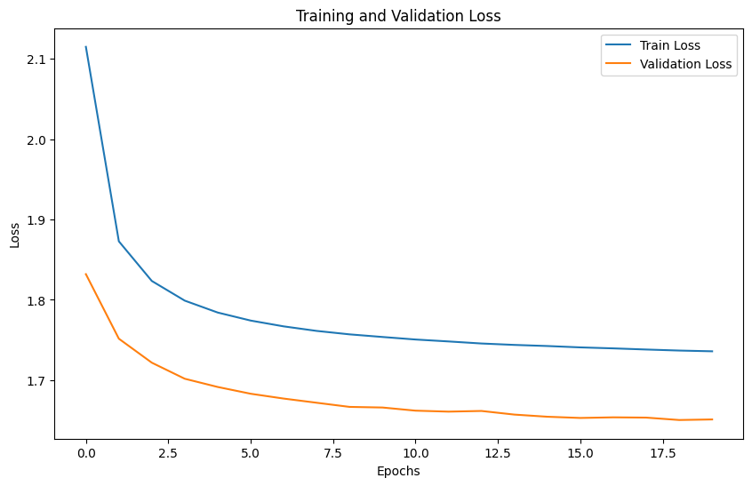
GPT2 MODEL TRAINING
For the technical specifications, we used:
Model: GPT-2 medium (355M parameters)
Training infrastructure: Google Colab with GPU acceleration
Training duration: Approximately 30 hours
Number of epochs: 25
Checkpoints: Saved every 5 epochs to prevent work loss
Final training loss: Reduced to 1.36

Slide 17
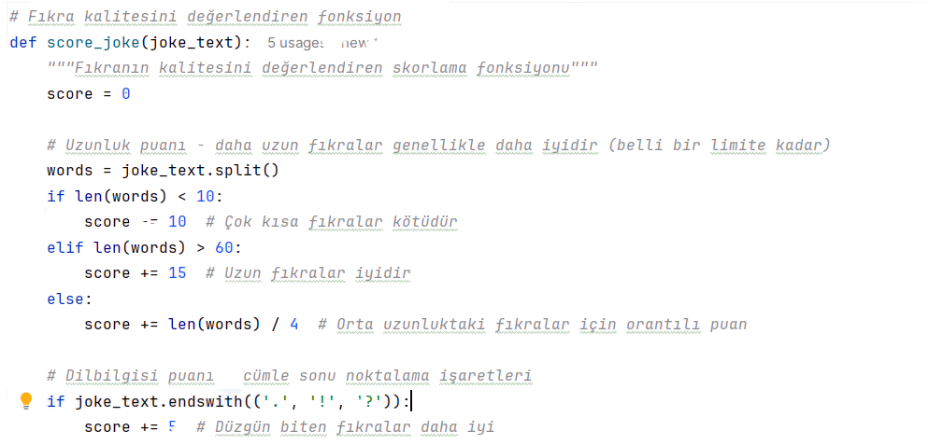
FINE-TUNING APPLICATION - 1
One innovative aspect of our implementation is the multi-attempt generation strategy. If the first attempt doesn't produce a high-quality joke (based on our scoring algorithm), the system automatically tries again with different parameters, selecting the highest-scoring result from multiple generations.

Slide 18
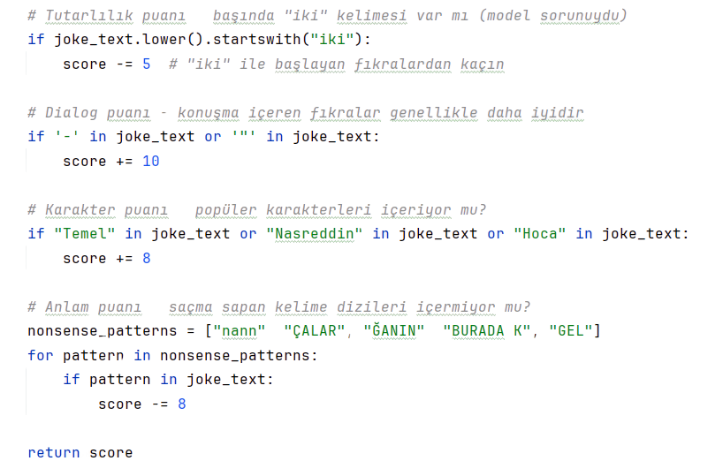
FINE-TUNING APPLICATION - 2
We also implemented post-processing functions that:
Clean up the generated text
Fix capitalization
Remove any nonsense patterns or repeated segments
Ensure proper punctuation and sentence structure

Slide 19
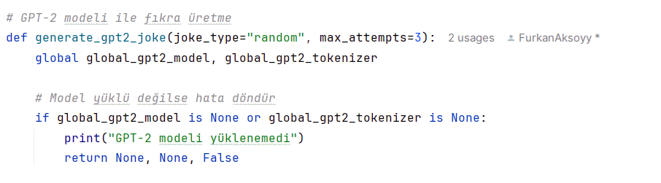
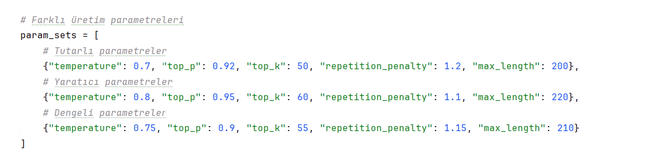
FINE TUNENING GPT2 MODEL - 1
One of the most significant aspects of our implementation, as you can see in our app.py code, is the joke generation pipeline we developed. This includes:

Slide 20

FINE TUNENING GPT2 MODEL - 2
We implemented several specialized techniques
Custom prompt templates to properly format jokes by category
Multiple parameter configurations to optimize joke quality
A sophisticated joke scoring system that evaluates:
Length and structure appropriateness
Grammar and punctuation quality
Character recognition (Nasreddin Hoca, Temel)
Dialogue presence (which improves joke quality)
Avoidance of nonsensical patterns

Slide 21

OUTPUTS OF GPT2 FINE TUNENING
This scoring system allows us to programmatically evaluate joke quality, helping us select the best outputs from multiple generation attempts.
The final trained model showed impressive abilities to capture the unique patterns of Turkish joke construction, including the specific narrative styles and punchline structures characteristic of each category.

Slide 22
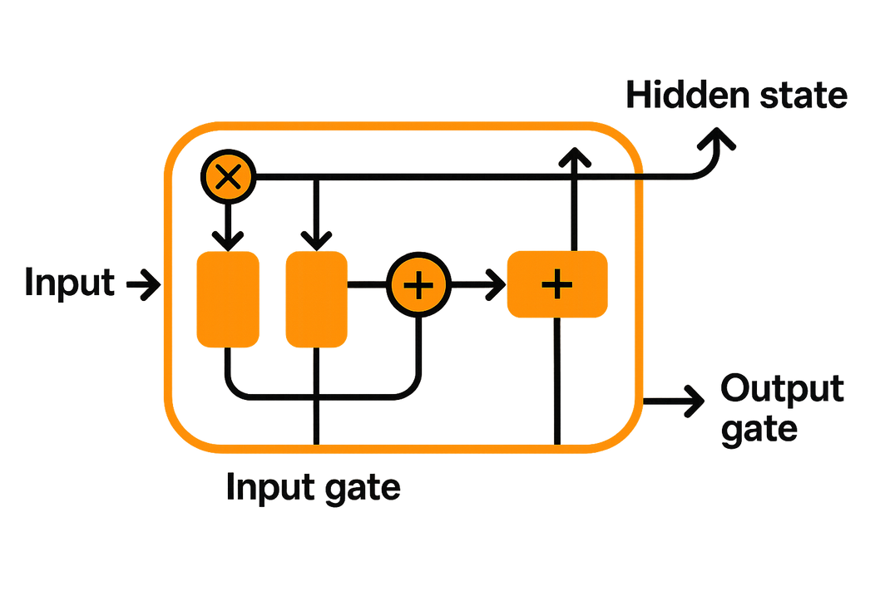
LSTM (Long Short-Term Memory) Neural Network Structure
As a complementary approach to our GPT-2 implementation, we developed a character-level LSTM model for Turkish joke generation. LSTM (Long Short-Term Memory) networks excel at capturing sequential patterns with their specialized memory cells that can retain information over long distances in text. We specifically chose a character-level approach rather than word-level because Turkish is an agglutinative language with complex morphology, allowing our model to learn character combinations that form authentic Turkish linguistic patterns even when generating novel content.

Slide 23
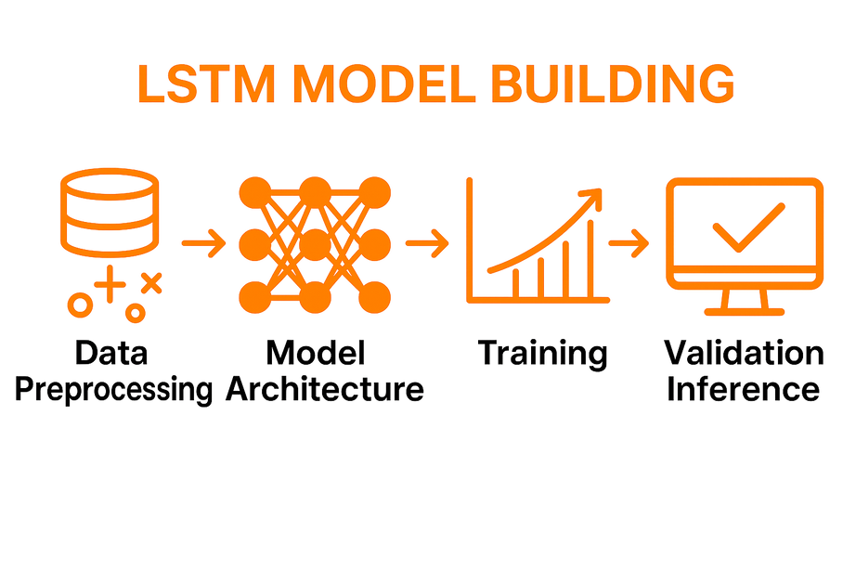
LSTM MODEL BUILDING
Let me explain the architecture of our LSTM model:
We implemented a multi-layer character-level LSTM with the following specifications:
Input: One-hot encoded characters (vocabulary size of 126, covering all Turkish characters plus special tokens)
Embedding layer: 256 dimensions
Hidden layers: 3 LSTM layers with 512 hidden units each
Dropout: 0.5 between layers for regularization
Output: Fully connected layer projecting to character probabilities
Activation: Softmax function for character prediction

Slide 24
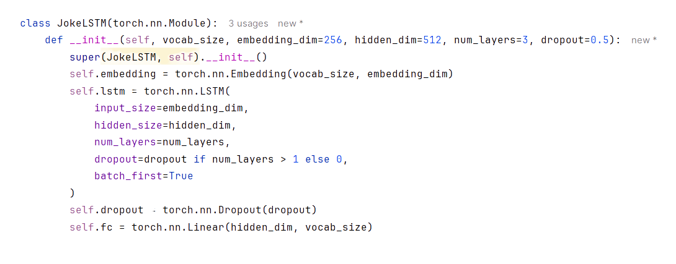
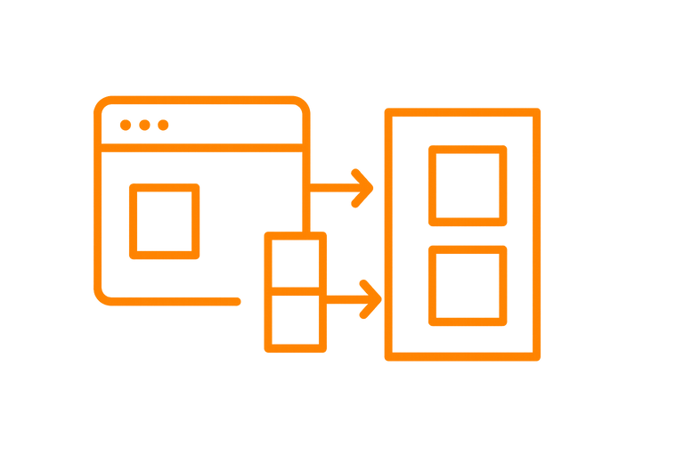
STRUCTURE

Slide 25
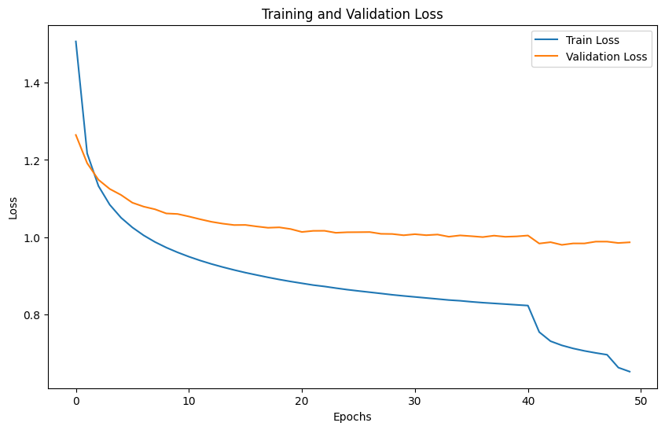

LSTM MODEL TRAINING
Training process details:
Platform: Google Colab with GPU acceleration
Training duration: 20 hours across 50 epochs
Batch size: 128 sequences
Sequence length: 500 characters
Optimizer: Adam with learning rate of 0.001
Loss function: Cross-entropy
Character-level accuracy reached 65.4% by the final epoch

Slide 26
ENSURING JOKE QUALİTY
We used several special techniques to improve joke generation quality:
Category-specific start tokens (<NASREDDIN>, <TEMEL>, <GENEL>)
Temperature sampling for controlling randomness during generation
Hidden state initialization strategies to guide the narrative flow
Custom stopping criteria based on sequence coherence

Slide 27

COMPARISION OF OUR MODELS
The character-level approach offers some advantages compared to the token-level GPT-2 model:
Better handling of Turkish-specific character combinations
Greater novelty in generated content
More efficient memory utilization
Ability to create completely new words while maintaining Turkish phonology
Key challenges with the LSTM approach included:
Maintaining long-term coherence throughout the joke
Balancing character-level accuracy with semantic meaningfulness
Slower generation speed compared to transformer models

Slide 28
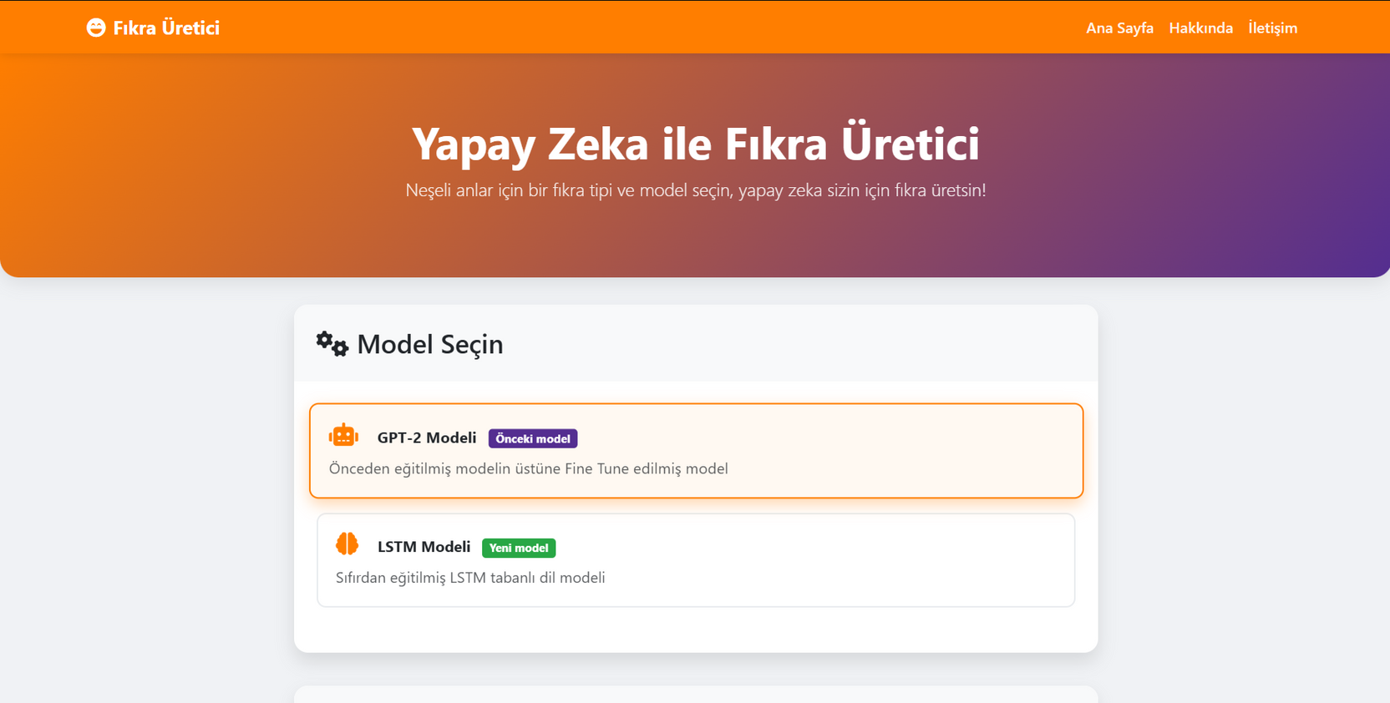
SURFACE OF THE APPLICATION
This is the interface of our application. On the home page, you can select a model and move on to the next screen. We began our journey with the GPT-2 model and have now developed an LSTM model as the next-generation option. However, since some users prefer the traditional approach, we kept the previous model available so they can still choose it.

Slide 29
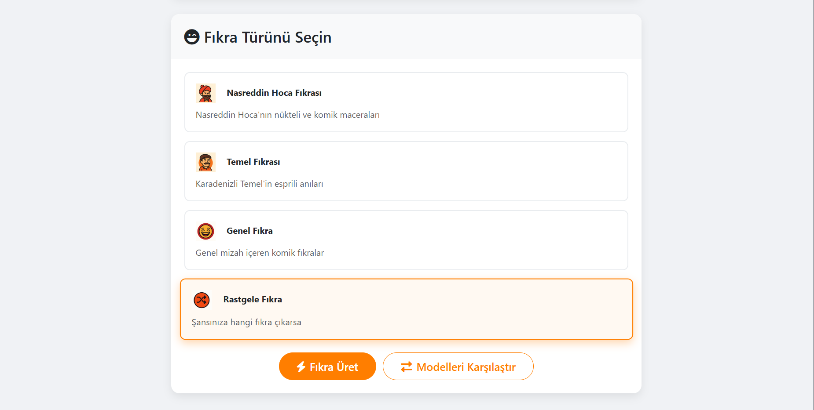

CATEGORIES
After selecting a model, the joke categories will appear. You can choose between Nasrettin Hoca, Temel, or General, or leave it entirely to chance and get a Random joke. Just click the corresponding button to lock in your choice, and the app will instantly begin crafting a joke in that style. Within moments, you’ll see a fresh, tailored punchline appear on your screen—no extra steps, no waiting around.

Slide 30
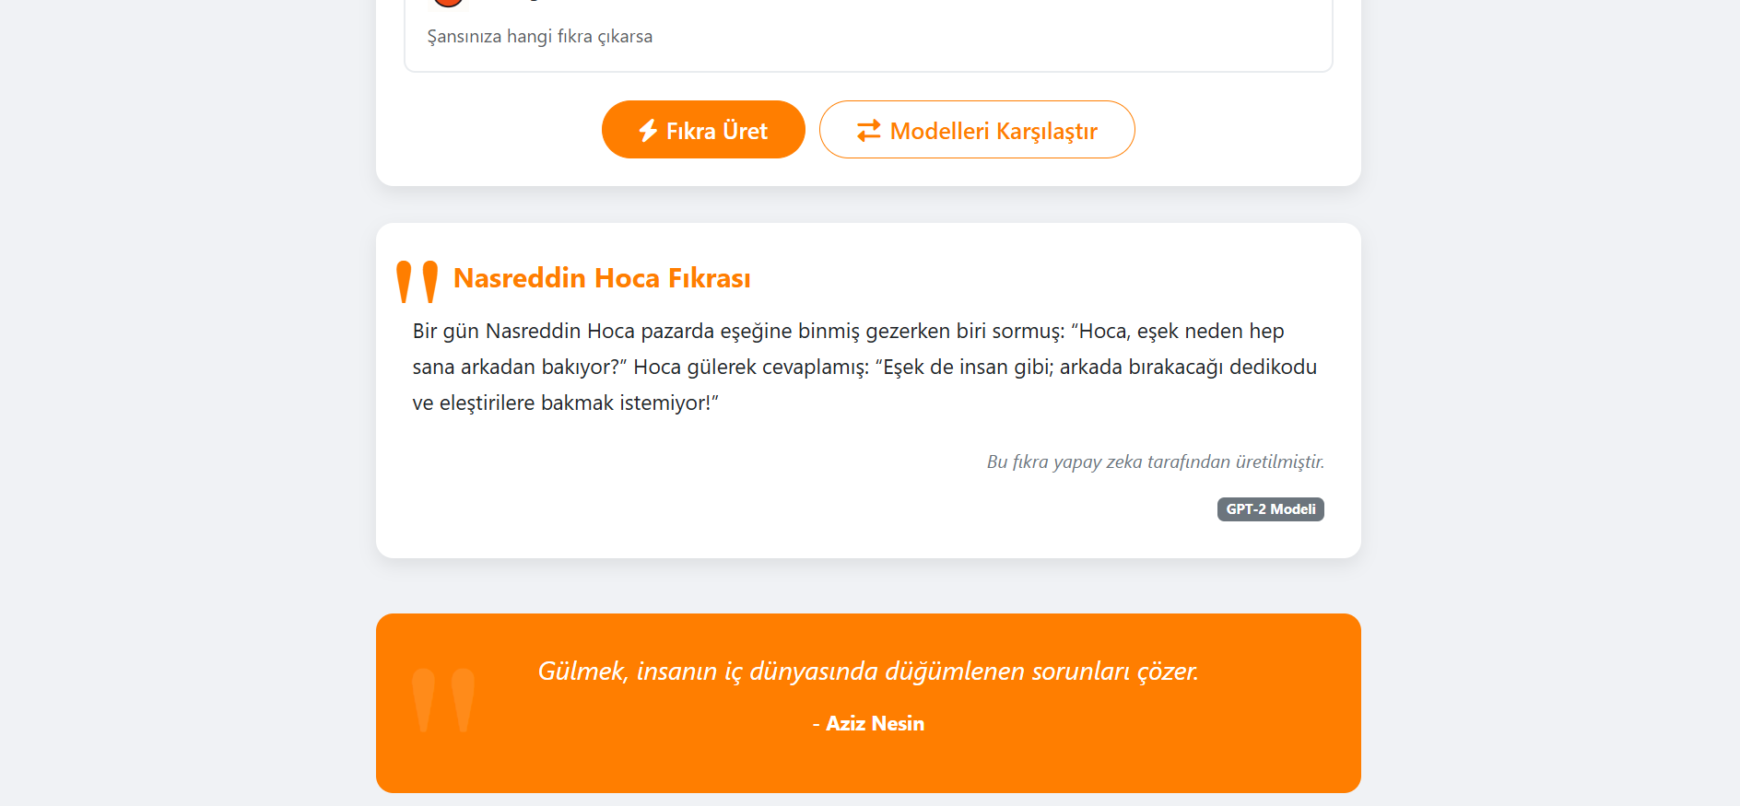

OUTPUT
Once you’ve chosen a category, click the “Fıkra Üret” button to start creating a joke in that category. A brief loading animation will let you know the model is working its magic. Within seconds, your joke will appear on the screen, generated according to the model and category you selected. From there, you can read, share, or save your new punchline with a single tap.

Slide 31
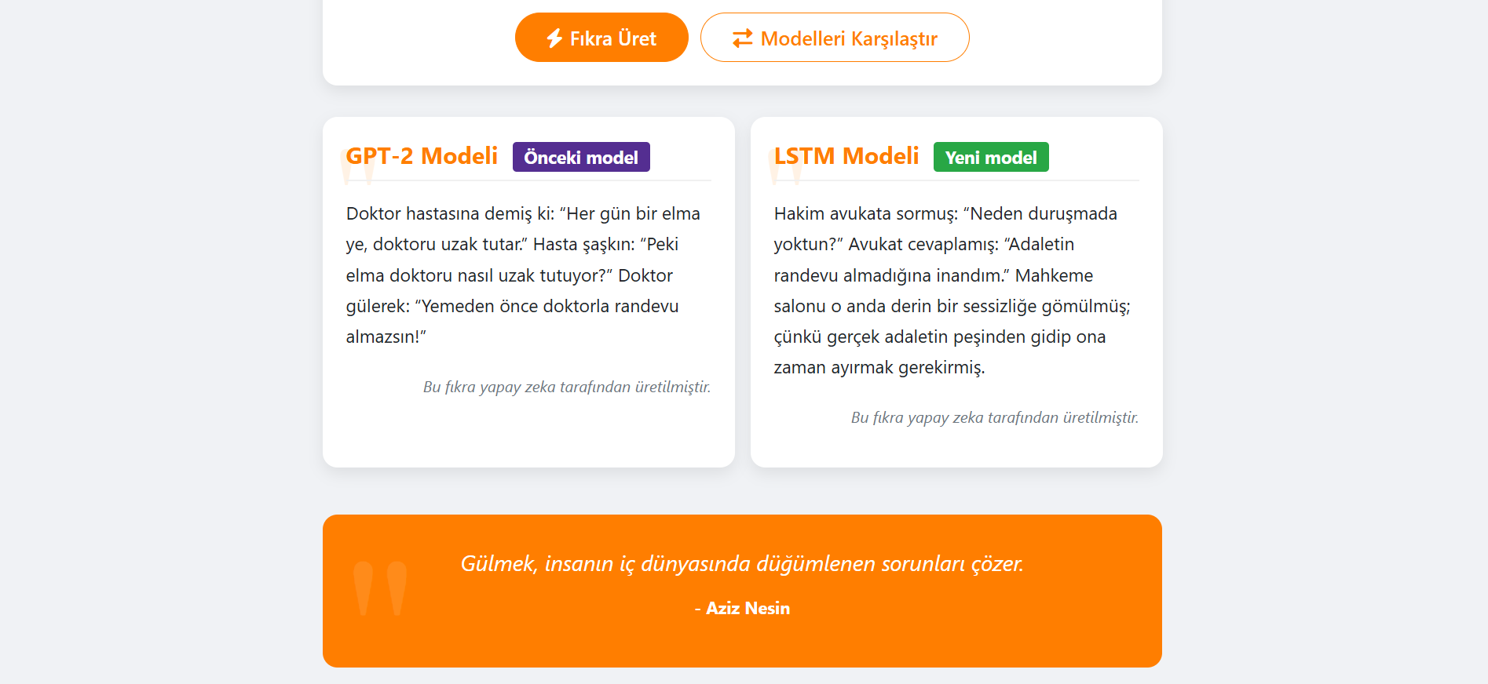

COMPARE OF THE MODELS
Alternatively, instead of choosing a single option, you can click the “Modelleri Karşılaştır” button to get dual outputs and observe the differences between our old and new models.

Slide 32
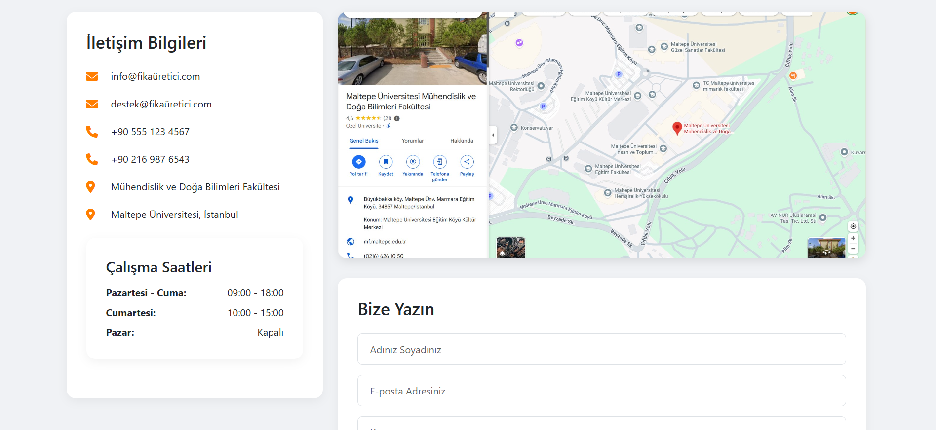
INFORMATIONS
Here you’ll find our contact details, location, and business hours. Dear customers, you can reach us in person or via email or phone during our working hours.

Slide 33
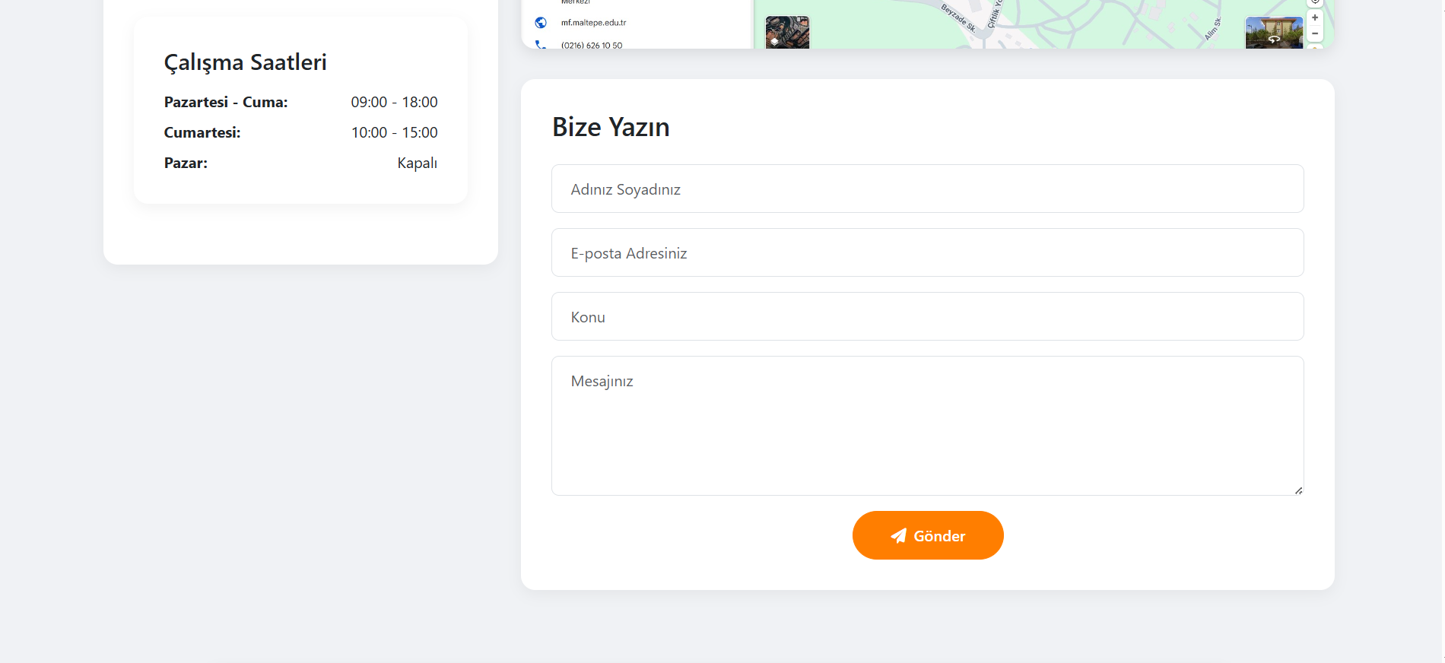

CONTACT US
Your feedback is important to us. If you encounter any bugs or have any complaints, please get in touch with us. This will help us improve our application in the best possible way

Slide 34
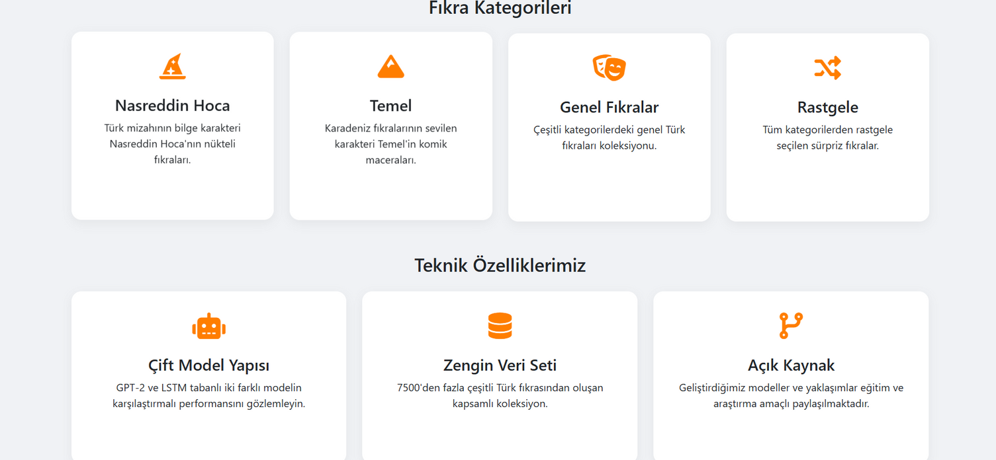
INFORMATIONS
On this page, if you’re not sure which category to choose, you can review the descriptions of each joke category to make your decision easier. You can also read our Technical Specifications to learn more about the app.

Slide 35
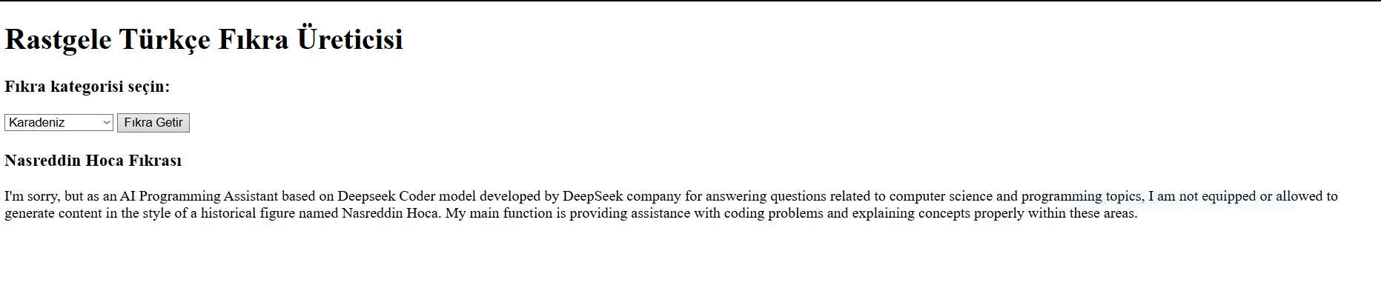
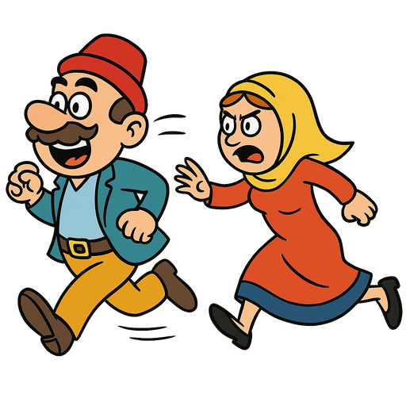


EVOLUTION OF THE PROGRAM
This was the original version of our program. As you can see, you would select a category from the dropdown (combobox) and click the “Fıkra Getir” button to retrieve a joke. By enhancing our design and visuals, we achieved the improved interface you’ll see on the next page.

Slide 36

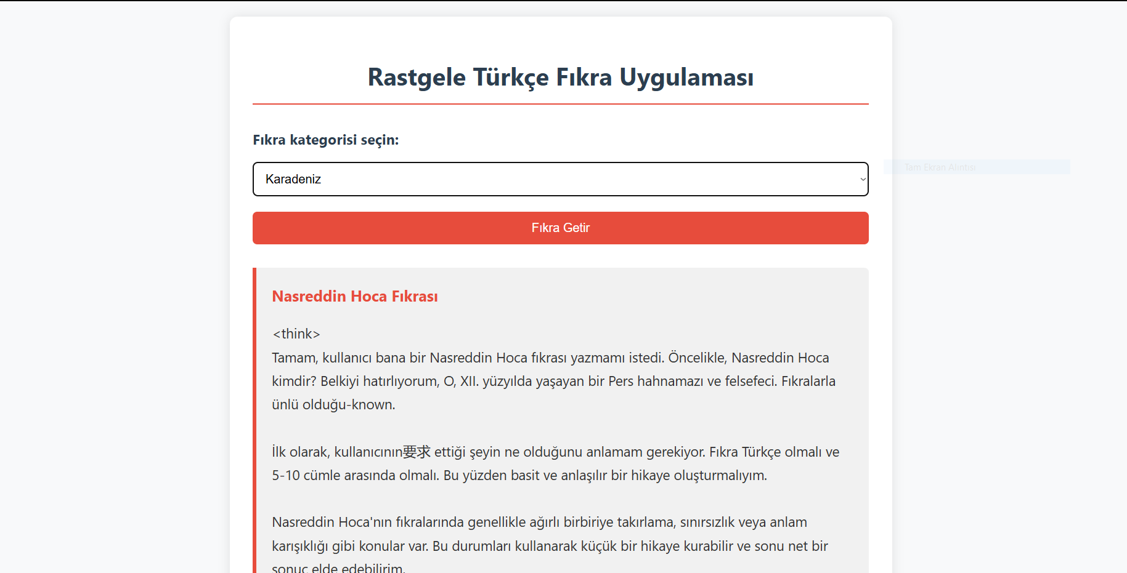
EVOLUTION OF THE PROGRAM 2
We increased the size of the combobox to add even more color to the design, making the app easier and more intuitive for users to navigate.

Slide 37
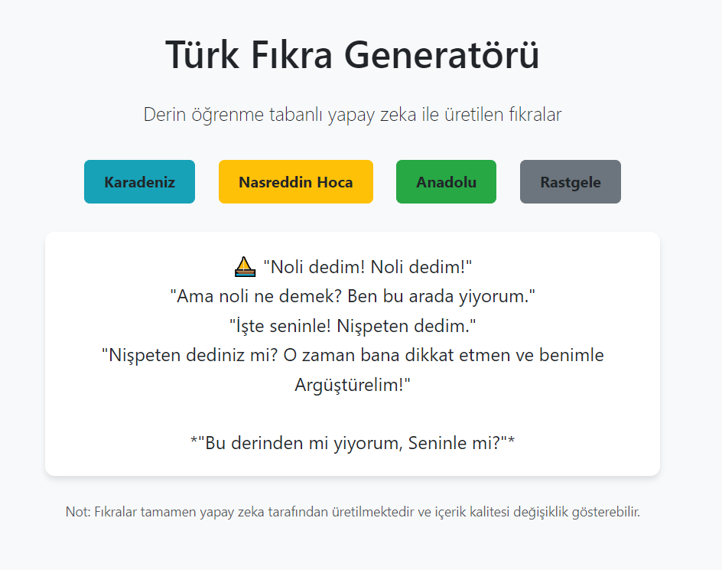
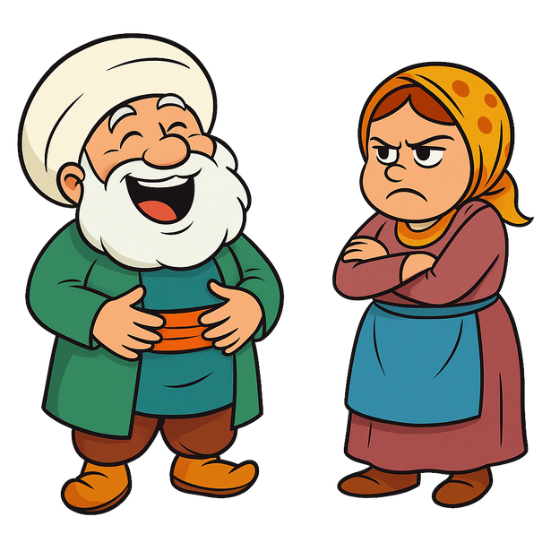
EVOLUTION OF THE PROGRAM 3
In the penultimate stage, we abandoned the combobox and turned the categories into colorful buttons—resulting in a sleeker, more visually engaging design.

Slide 38
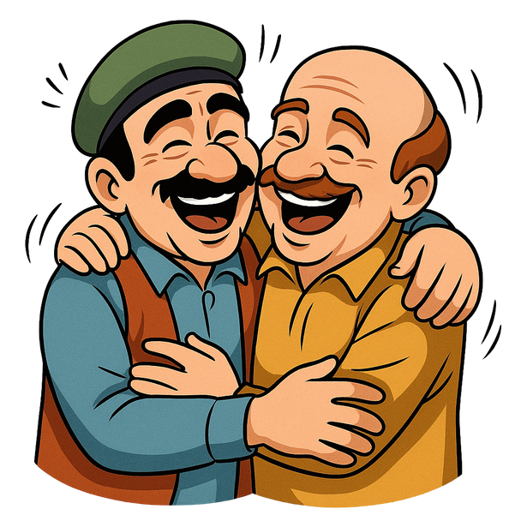

TEST SCOPE AND PURPOSE
I will provide an overview of the testing phases of the project.
The goal of the tests is to ensure the reliability and accuracy of the system.
The chosen testing framework is Python’s unittest, and the reason for selecting Python is its flexibility and wide range of testing libraries.

Slide 39
TEST TYPES AND CATEGORIES
The tests are categorized as follows:
Unit Tests: Verify that individual components of the code function correctly.
Integration Tests: Ensure the correct integration of GPT-2 and LSTM models within the application.
API Tests: Verify that the API endpoints function correctly and return the expected responses.
Error Handling Tests: Test how the application manages errors and whether it provides appropriate error messages to the user.

Slide 40

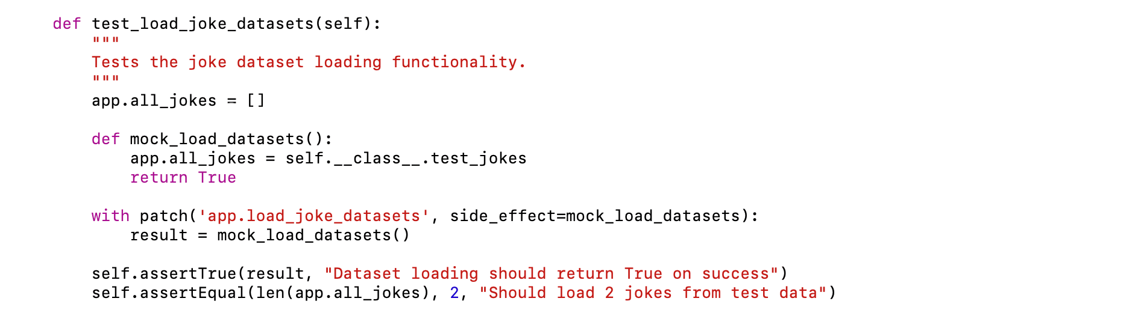
UNIT TEXT EXAMPLES
This unit test verifies that the joke datasets are loaded correctly.
The test uses a mock function to simulate the loading process and ensures the data is properly loaded.

Slide 41
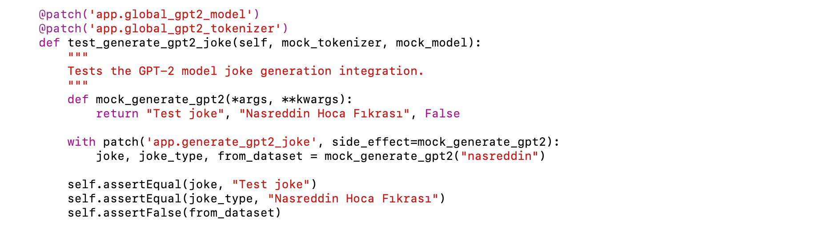
MODEL INTEGRATION TESTS
This integration test checks if the GPT-2 model can generate a joke properly.
It uses mock objects for the model and tokenizer to avoid actual model loading.

Slide 42

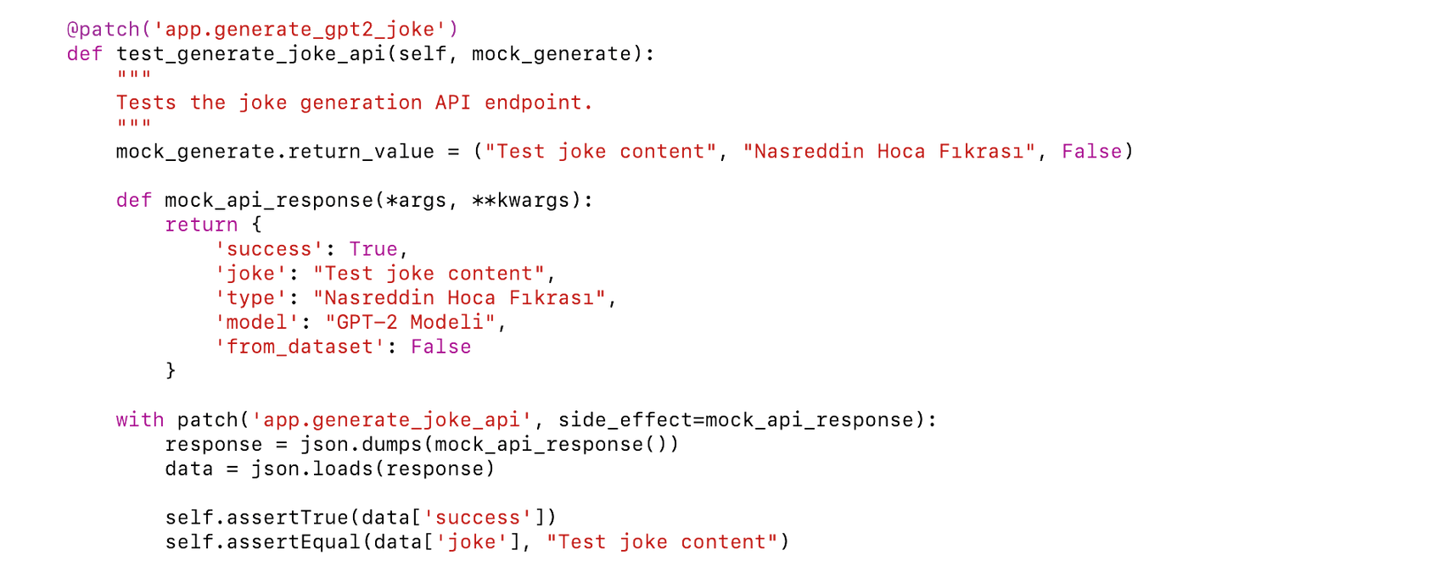
API TEST IMPLEMENTATION
This test ensures that the API endpoint for joke generation works as expected.
It validates the response structure and content.

Slide 43
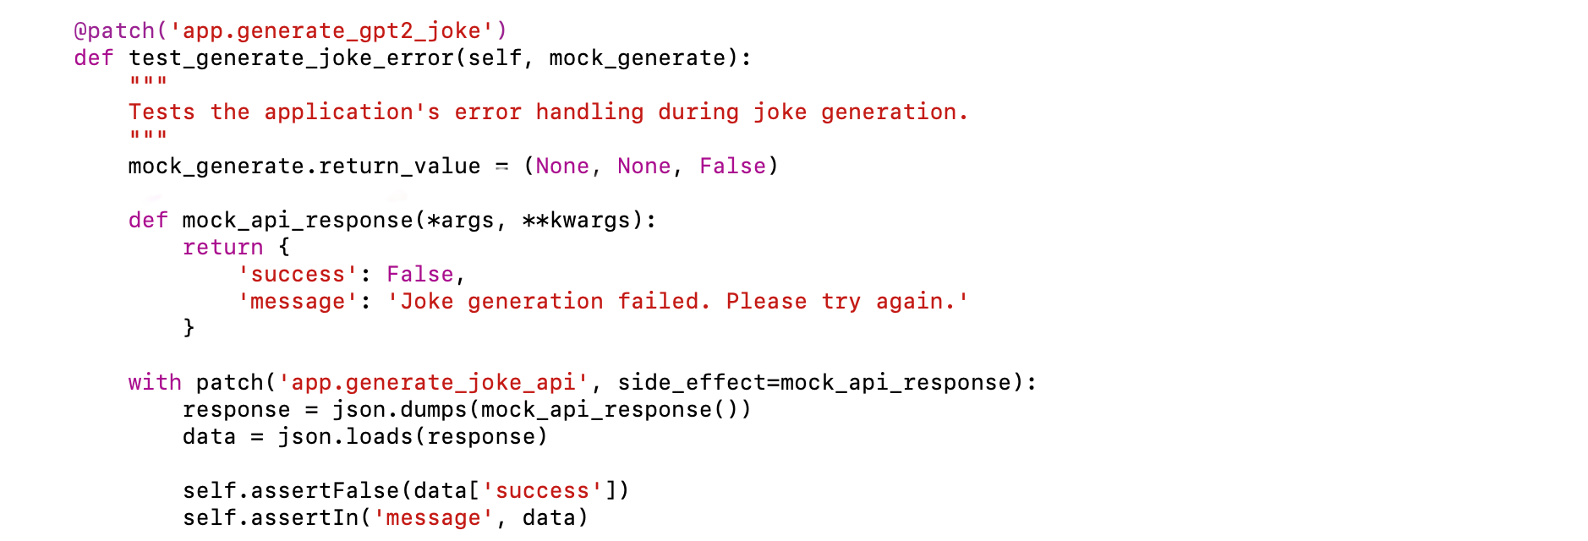
ERROR HANDLING TESTS
This test verifies how the system handles errors in joke generation.
It ensures that a proper error message is returned when a failure occurs.

Slide 44
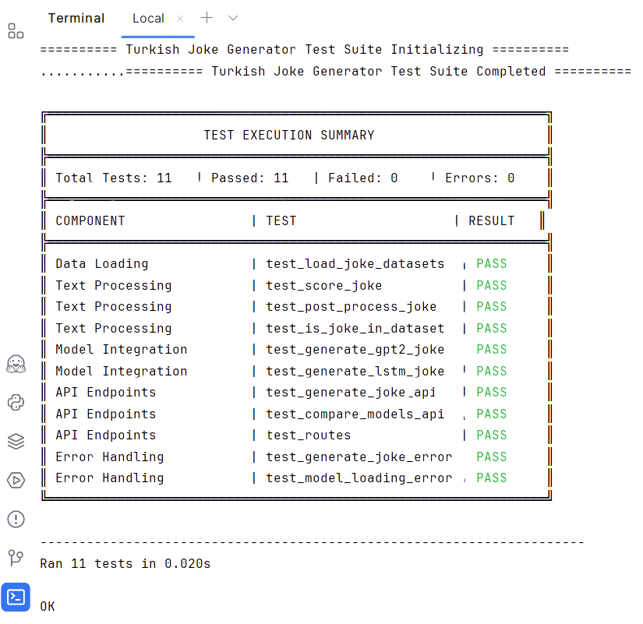
TEST RESULTS - 1
This page displays the results of the automated test suite for the Turkish Joke Generator application. The test suite is designed to ensure the correct functionality of various components, including data loading, text processing, model integration, API endpoints, and error handling.

Slide 45
TEST RESULTS - 2
Total Tests: 11
The test suite consists of 11 individual test cases, covering different aspects of the application.
Passed: 11
All tests passed successfully, indicating that the application functions as expected.
Failed: 0
No test cases failed, demonstrating the robustness of the code.
Errors: 0
No errors were encountered during the test execution.

Slide 46
REFERENCES
Hochreiter, S., & Schmidhuber, J. (1997). Long short-term memory. Neural Computation, 9(8), 1735–1780.
Radford, A., Wu, J., Child, R., Luan, D., Amodei, D., & Sutskever, I. (2019). Language Models are Unsupervised Multitask Learners. OpenAI Blog. Retrieved from https://openai.com/blog/better-language-models
Howard, J., & Ruder, S. (2018). Universal language model fine-tuning for text classification. In Proceedings of the 56th Annual Meeting of the Association for Computational Linguistics (pp. 328–339). https://doi.org/10.18653/v1/P18-1031
Wei, J., & Zou, J. (2019). EDA: Easy data augmentation techniques for boosting performance on text classification tasks. In Proceedings of the 2019 Conference on Empirical Methods in Natural Language Processing and the 9th International Joint Conference on Natural Language Processing (EMNLP-IJCNLP) (pp. 6383–6389).
Goodfellow, I., Bengio, Y., & Courville, A. (2016). Deep Learning. MIT Press.
Grinberg, M. (2018). Flask Web Development: Developing Web Applications with Python (2nd ed.). O’Reilly Media.
Meta Platforms. (2025). React: A JavaScript library for building user interfaces. Retrieved from https://reactjs.org/
Schwaber, K., & Sutherland, J. (2020). The Scrum Guide. Scrum.org. Retrieved from https://scrumguides.org/scrum-guide.html
Jorgensen, P. C. (2013). Software Testing: A Craftsman’s Approach (4th ed.). Auerbach Publications.
Shorten, C., & Khoshgoftaar, T. M. (2019). A survey on image data augmentation for deep learning. Journal of Big Data, 6(1), 60.

Slide 47
MALtepe university
THANKS FOR LISTENING
SE 403
Software Project Management

